Slide 1

Study on Performance of PI controller with structural modification including computer control of an OWI robotic arm
Presented by
-Sumaiya Saima Sultana
A presentation on graduation thesis

Slide 2
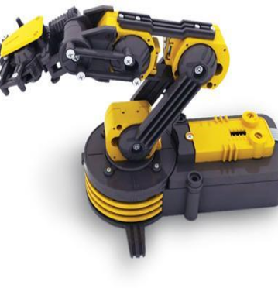
Introduction
This thesis represents the study of a PI controller of a 5 DOF OWI-535 Robotic Arm Edge with some structural modifications. These modifications have paved the way for introducing feedback control system for the PMDC motors used in the arm. A control circuit has been designed for this particular study. The design has been implemented on a PCB and all the design considerations have been discussed thoroughly in the paper. This paper studies the performance of P controller as well as PI controller at various experimental conditions. The optimum values for the controller gains Kp and Ki have been tuned manually and the resulted graphs properly validates standard behaviors of P controller and PI controller

Slide 3
Implementing feedback control system:
Feedback control system: A feedback control system is a system whose output is contrlled using its measurement as a feedback signal. This feedback signal is compared with a reference signal to generate an error signal which is filtered by a controller to produce the system's control input.
Initially the arm had DC motors which had no feedback option. To gain proper control of the arm and for programming advantage, the DC motors have been modified to servo motors using potentiometers.
In order to control the shaft position of a DC motor (and thereby convert it into a servo motor), it is needed to ‘encode’ the position of the shaft. This ‘current position’ will be compared against a ‘desired position’ and a ‘positional error’ will be generated. Voltage applied to the motor terminals will be so as to cause the shaft to turn to reduce ‘positional error’ to zero.

Slide 4
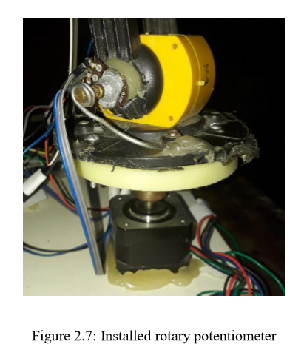
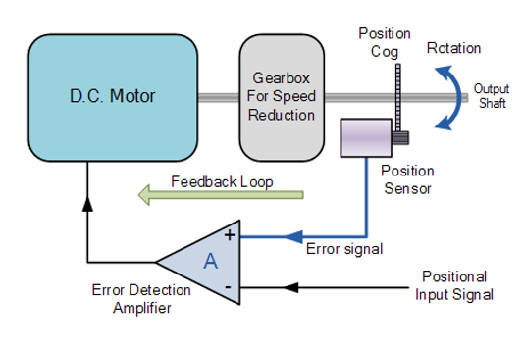
Implementing feedback control system:
Figure: Feedback control system

Slide 5
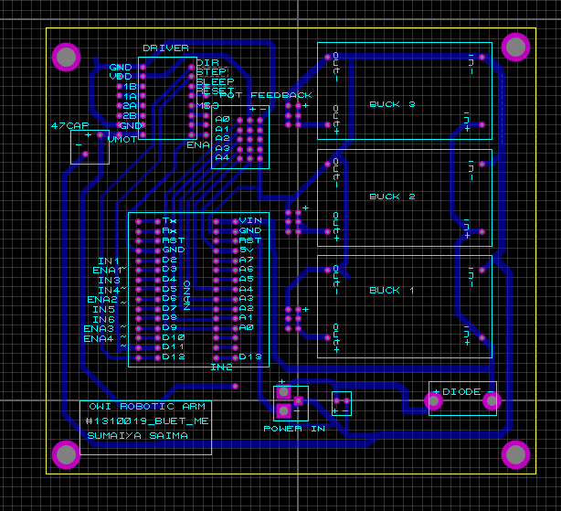
Designing control circuit:
Figure: Design of the control circuit in PCB using Proteus

Slide 6
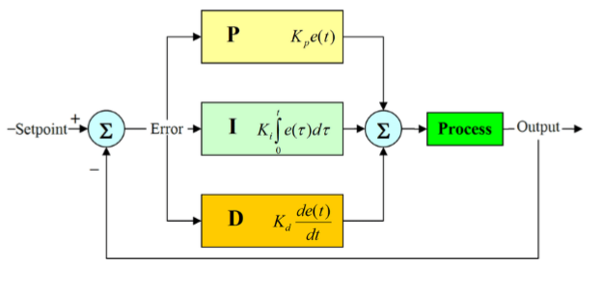
Feedback controlling with PI controller:
PI controller: A proportional–integral–derivative controller (PID controller) is a generic control loop feedback mechanism(controller) widely used in industrial control systems. A PID controller calculates an “error” value as the difference between a measured process variable and a desired set point.
Figure: Basic block diagram for PID controller

Slide 7
Example result with PI controller:
Figure: Fluctuation depending on Kp values demonstrates necessity of proper tuning of Kp,Ki values

Slide 8
Thank you!

